Slide 1
SHWN_NXTH (NEX3PL LLC)
Always key the following, visible in the invoice separator sheet:
Batch ID (68a) BAT ID (69) Value/No
Client Code (68b) CL CODE (69) SHWN Scac Code (68c) SCAC CODE (69) NXTH

Slide 2
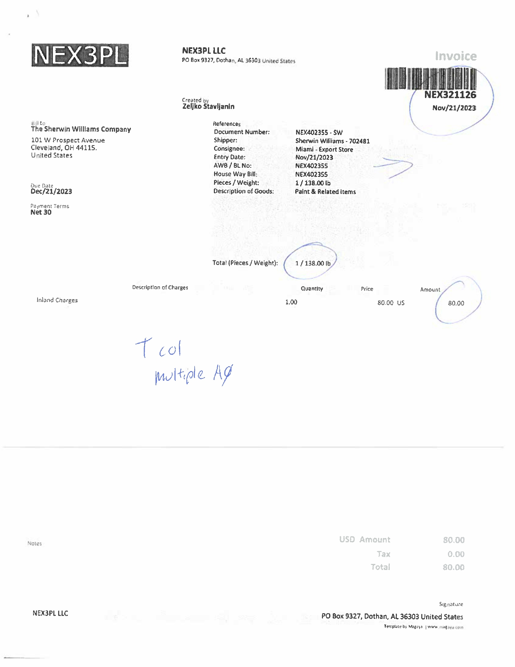
01
68a AWB
68b HAWB
01 REMIT TO
02 BILL TO
03 INV KEY
10 DATE
27 SHIPPER INV
30 CONSIGNEE INV
61 PICK UP
90 PROD DESC
46 PIECES
47 PIECES TYPE
42 ACTUAL WT
43 FNCL WT
44 ACTUAL WT UOM
45 FNCL WT UOM
11 DUE
72 LINE ITEM DESC
74 LINE ITEM QTY Q
75 LINE ITEM RATE
85 LINE ITEM AMT
08 INV AMT
14 FB AMT
09 CURR
03
27
68a
10
68b
30
02
61
47
46
90
11
42/43
44/45
72
74
75
85
09
08/14

Slide 3
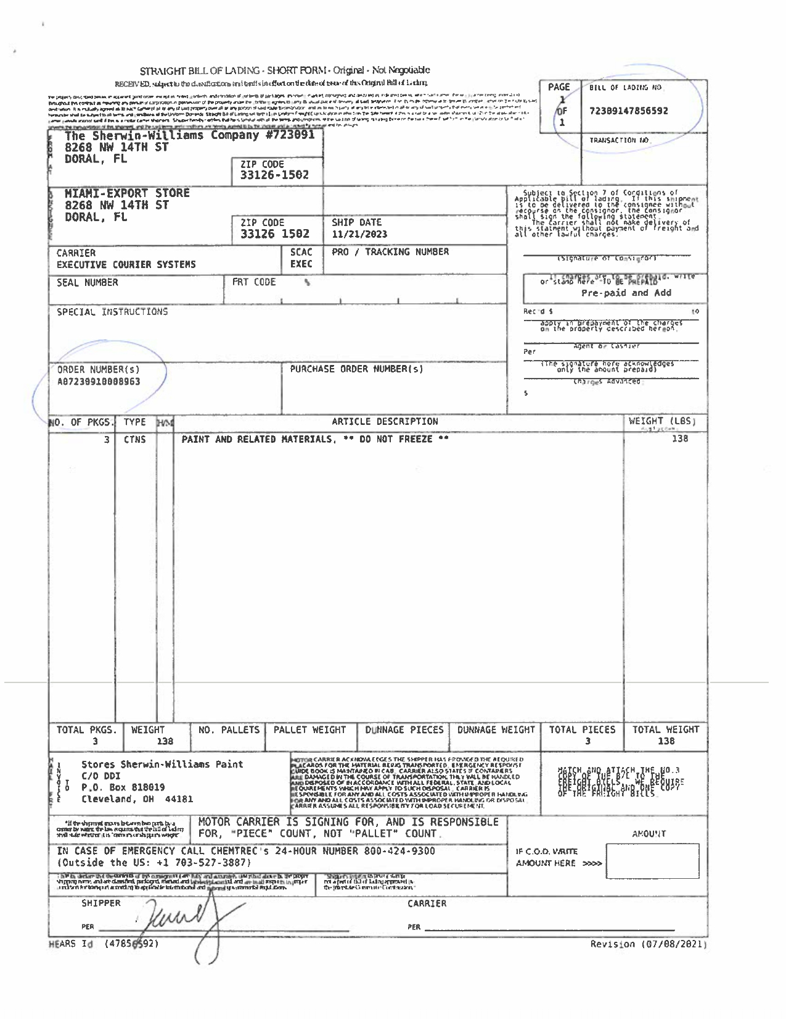
68a
28
68a BOL
28 SHIPPER BOL
31 CONSIGNEE BOL
36 FRGHT TERM
68b ORD NO
90 PROD DESC
95 PCS CNT
96 GROSS WT
97 NET WT
98 WT UOM
31
68b
36
98
90
96/97
95

Slide 4
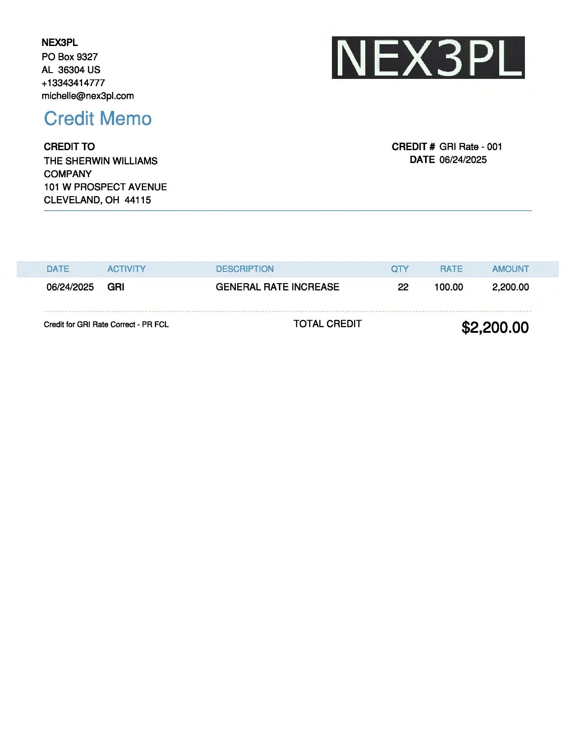
Credit Invoice
01
01 REMIT TO
02 BILL TO
03 INV KEY
10 DATE
72 LINE ITEM DESC
74 LINE ITEM QTY Q
75 RATE
85 LINE ITEM AMOUNT
08/14 INV AMT/FB AMT
03
02
10
85
08/14
72
74
75

Slide 5
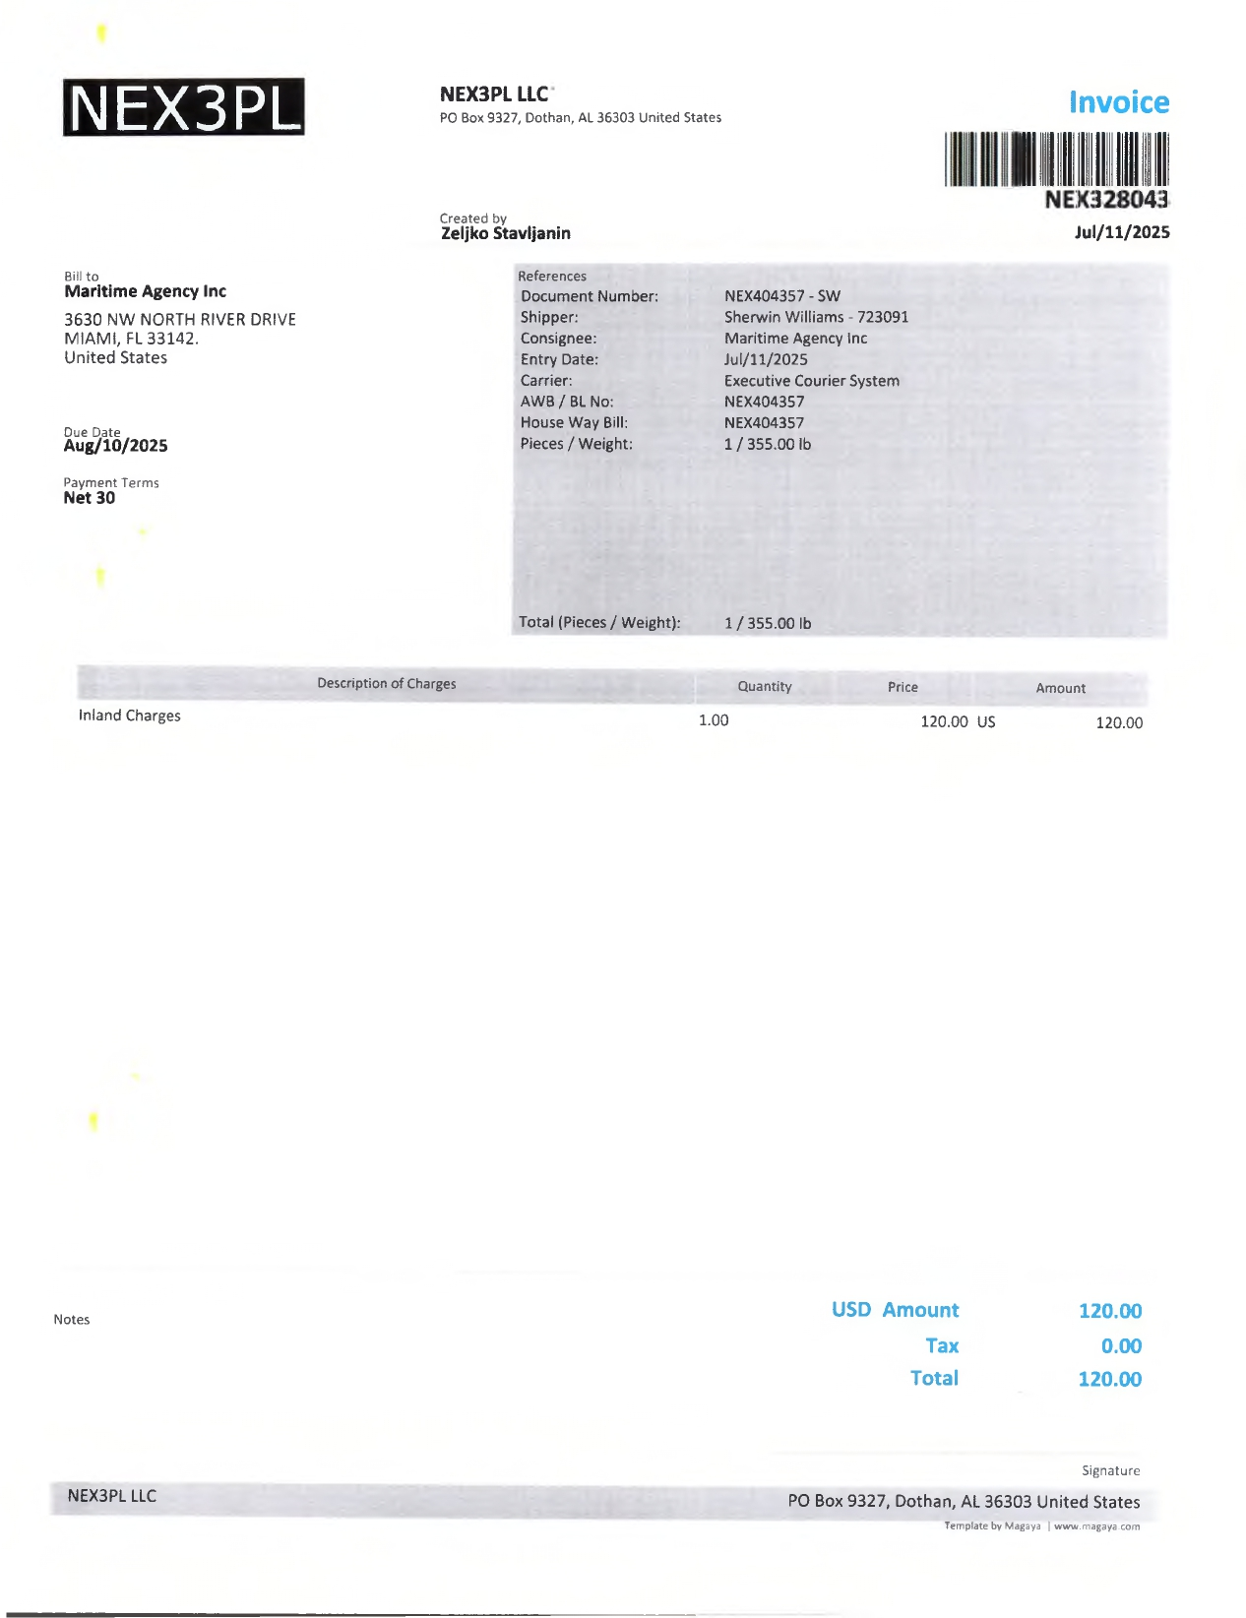
02
02 BILL TO

Slide 6
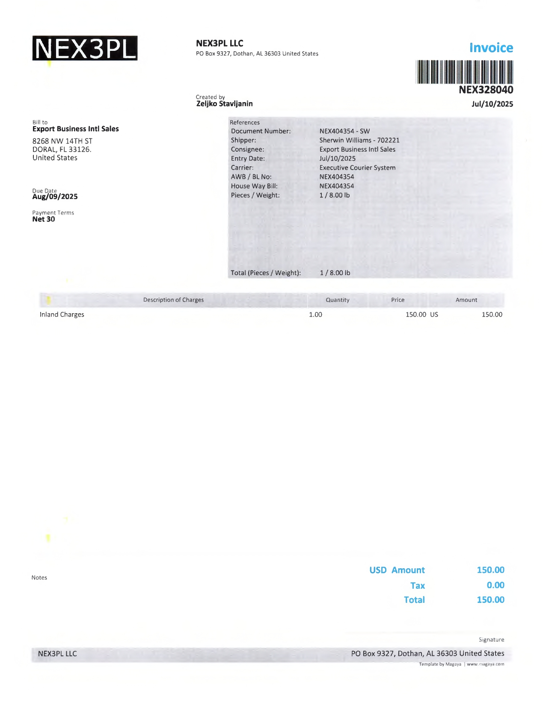
02
02 BILL TO

Slide 7
6
For Verification Table
 | NAME | DATE
DI-61494 | REGINE S. DERIADA | 7/10/2024
DI-71706 – Added new credit format (slide 4). | BABY G. VILLACARLOS | 6/26/2025
DI-72353 – Updated as instruction(slide 5 and 6) | KHEILA MARY A. INOC | 07/21/2025

